Slide 1
Parallel Computing for Enhanced Pneumonia Detection in X-Rays
Northeastern University
CSYE 7105 33798 - High-Performance Parallel Machine Learning and AI, Spring 2024
Instructor: Prof Handan Liu
Team 12
Tanmay Joshi & Devanshu Gohil

Slide 2
Contents
Introduction
Background
Motivation
Goals
Dataset
EDA
Methodology
EDA using Multiprocessing
Model Selection – DenseNet - 161
Model Training using Distributed Data Parallel
Model Evaluation using Dask
Training
Result and Analysis
Conclusion
References

Slide 3
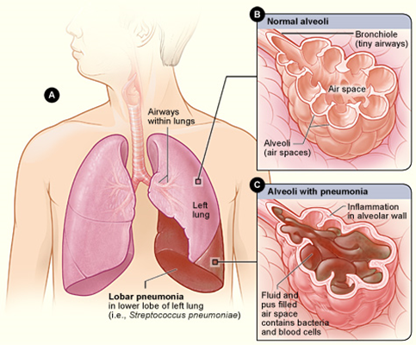
Background
Pneumonia is a serious lung infection affecting many globally, especially the young and old. Timely and correct diagnosis is critical for treatment, but conventional X-ray reading methods are slow and inconsistent in accuracy.
Hence, due to advancement in technology and AI, modern solutions include classification of patients’ images using deep learning models

Slide 4
Motivation
Pneumonia, a major global health issue, especially impacts the young and old; swift and precise X-ray diagnosis is key to lowering mortality.
Manual analysis of X-ray images is time-intensive and challenging for radiologists.
Machine Learning advancements offer solutions to improve the detection process.
Processing and training with large datasets demand significant computational power.
This project aims to use parallel computing to quicken and scale the analysis effectively

Slide 5
Goals
The aim of our project is to engineer a deep learning model that operates in parallel to classify weather images. The objectives include:
Model Design: Craft a deep learning architecture specifically tailored for the intricate task of Pneumonia image classification.
Parallelization Implementation: Apply various parallel computing techniques to bolster the model's training process, thereby increasing speed.
Performance Analysis: Conduct a thorough evaluation and interpret the efficacy of each parallelization strategy across different stages of the model's workflow.
Notes:
To accelerate the process
Used parallel as much as we could
Conducted a thorough analysis in order to evaluate the effectiveness of parallelization

Slide 6
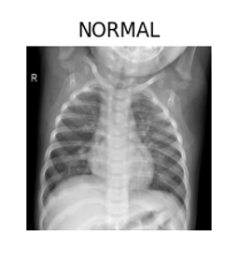
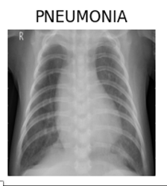
Dataset
The dataset is titled “Pediatric Pneumonia Chest X-ray” and is publicly available on Kaggle.
It consists of 5,863 X-Ray images categorized into pneumonia and normal conditions.
The images are grayscale and vary in size. For this project, images will be resized to a standard dimension to ensure uniformity.

Slide 7
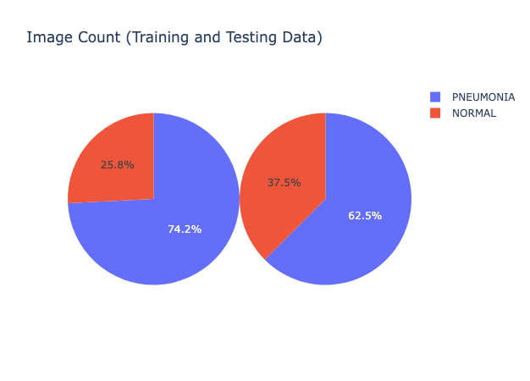
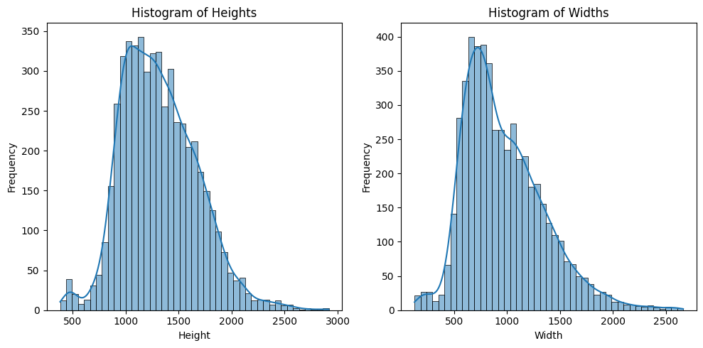
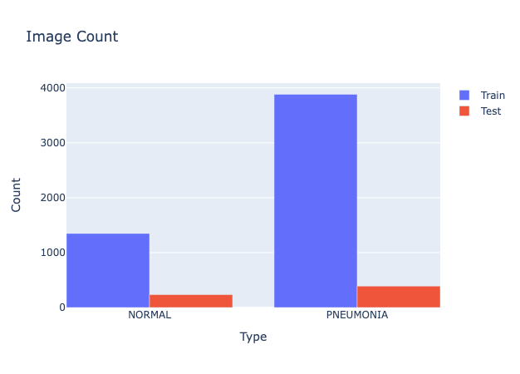
EDA(Exploratory Data Analysis)

Slide 8
Methodology
EDA using Multiprocessing
Model Selection – DenseNet - 161
Model Training using Distributed Data Parallel
Model Evaluation using Dask

Slide 9
EDA using Multiprocessing
EDA is essential for analyzing and cleansing data to guide the transformation choices during model training, ensuring optimal machine learning performance.
The primary challenge was the time-consuming process of loading approximately 6000 high-quality images for EDA.
Implemented Python’s multiprocessing library, specifically multiprocessing.Pool, to expedite the dataset loading process.
allowed distribution of image loading across multiple CPU cores, significantly reducing the time required versus sequential loading.

Slide 10
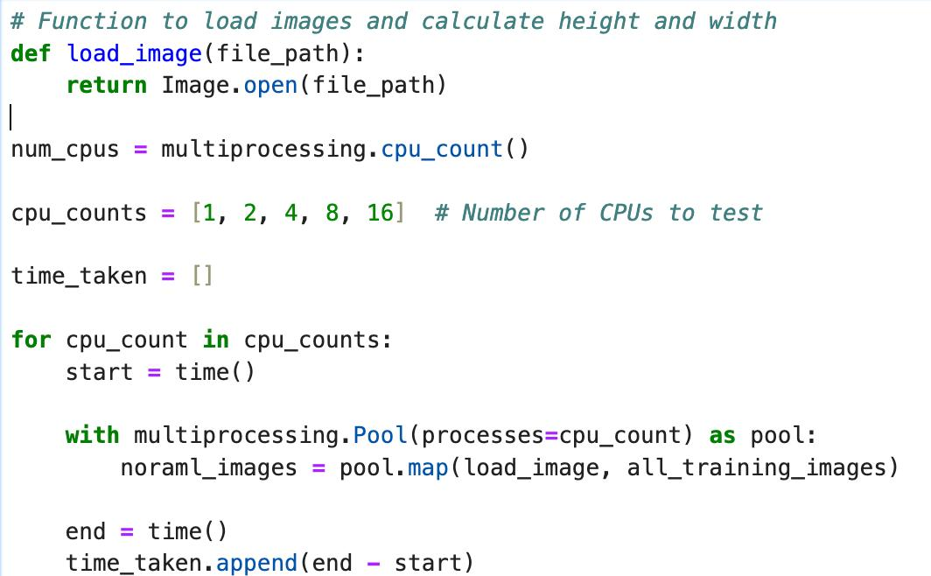
How?
Tested how well multiprocessing.Pool worked by running on 1,2,4,8,16 CPU cores, and found that more CPUs made data loading much faster.
tests showed that using more CPUs cut down the time needed to load data.
With more CPU cores, image loading became quicker, which is important for projects where time matters.

Slide 11
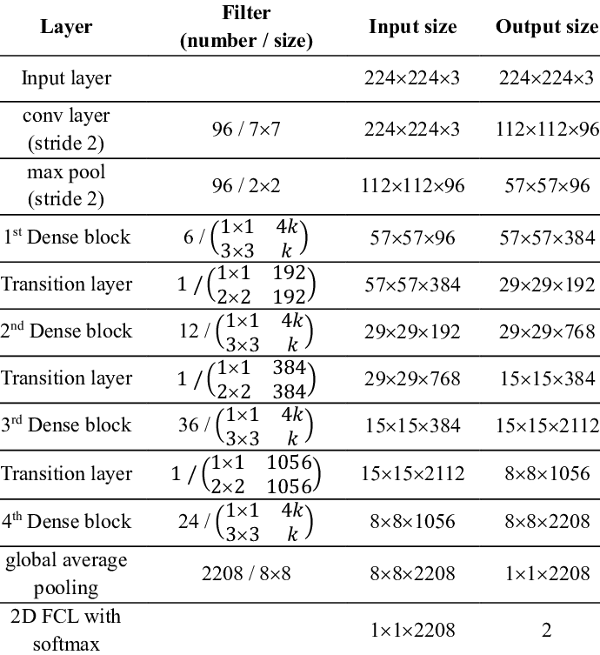
Model Selection: DenseNet-161
DenseNet-161's depth improves complex image classification.
Dense connections in DenseNet-161 help prevent gradient issues and strengthen feature learning.
The network's design reduces parameters, increasing efficiency for medical imaging.
Notes:
Implemented from scratch but accuracy was not up to the mark
Hence using a pretrained model became crucial
Handles data imbalance and gives good f1

Slide 12
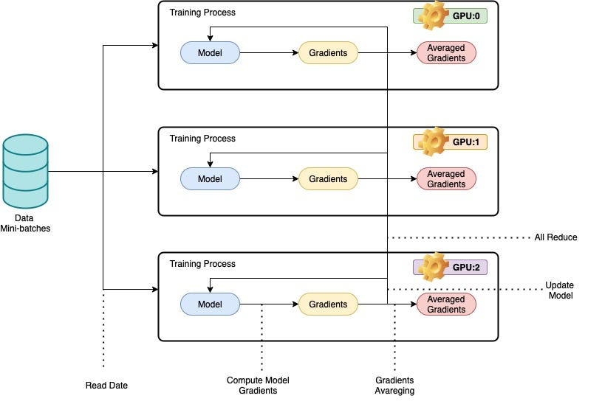
Model Training using Distributed Data Parallel
The method meets real-world needs by efficiently handling extensive datasets necessary for complex tasks like pneumonia detection in chest X-rays.
DDP accelerates training by dividing data and independently processing it on each GPU, with synchronized updates for consitency .
To use DistributedDataParallel on a host with N GPUs, you should spawn up N processes, ensuring that each process exclusively works on a single GPU from 0 to N-1.
Notes:
Why DDP over DP
What is DDP -> world size

Slide 13
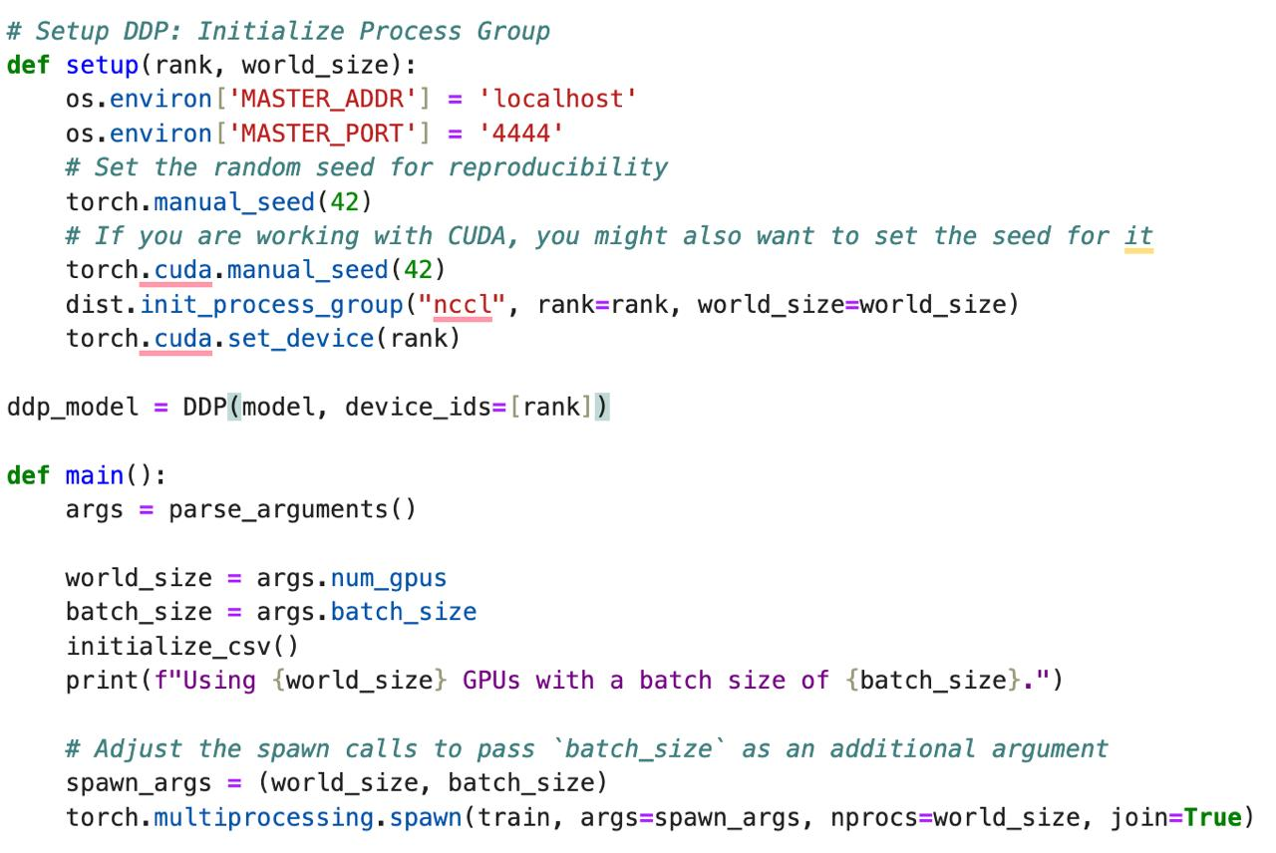
How?
Fitted the model for training across 4 GPUs for batch sizes of 32, 64, 128, 256 respectively.
Recorded the training times for model execution on 1, 2, 4 GPUs respectively.
Single-GPU setups showed increased training times with larger batch sizes, suggesting a cap due to limited computational power.
Four-GPU arrangements revealed the best use of DDP, with training times dropping as batch sizes increased, showcasing efficient distribution and scalability.
Notes:
Explain first point
How we did it -> explain code
Batch file implementation touch
Result overview

Slide 14
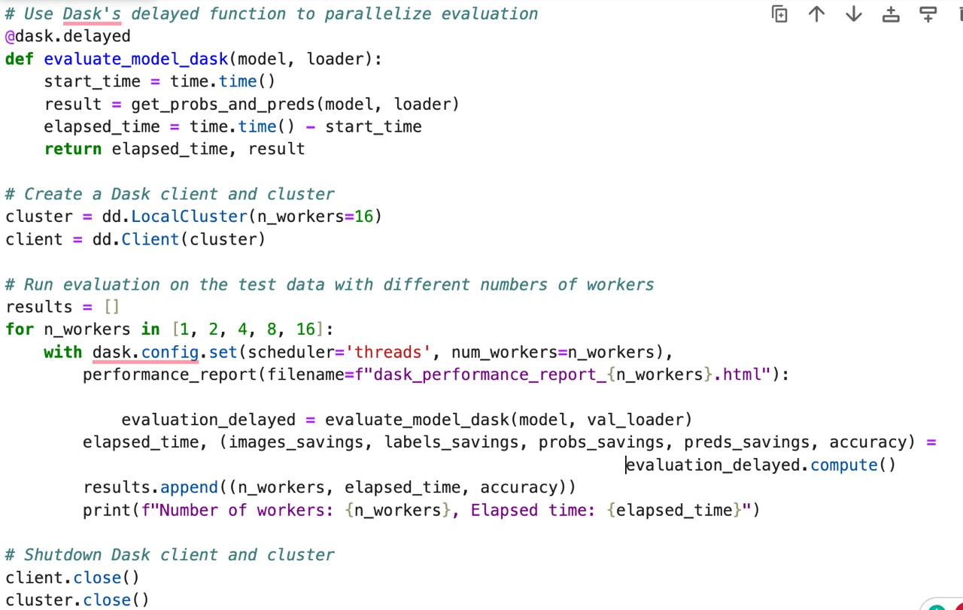
Model Evaluation using Dask
Implemented parallel evaluation of the deep learning model on test data utilizing Dask's delayed function across several workers for enhanced efficiency.
Reduced total computation time by distributing workload across multiple workers.
Created a Dask client and cluster for managing parallel computations.
Varied the number of workers to assess model performance under different computational loads.

Slide 15
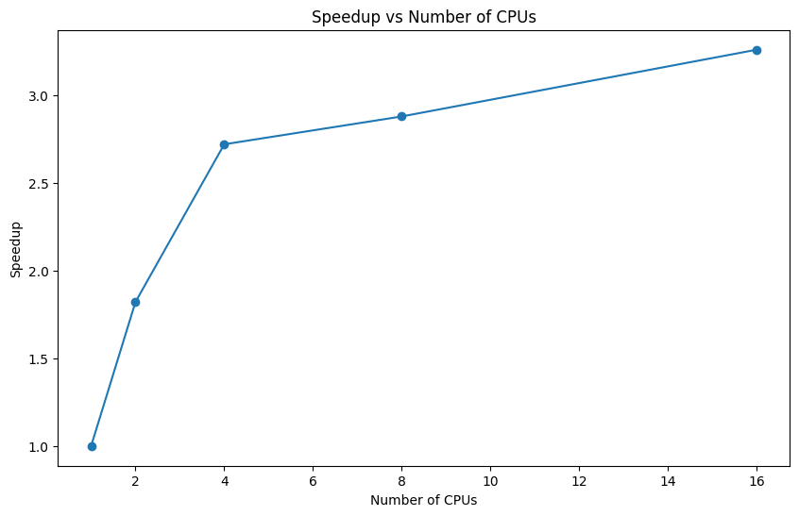
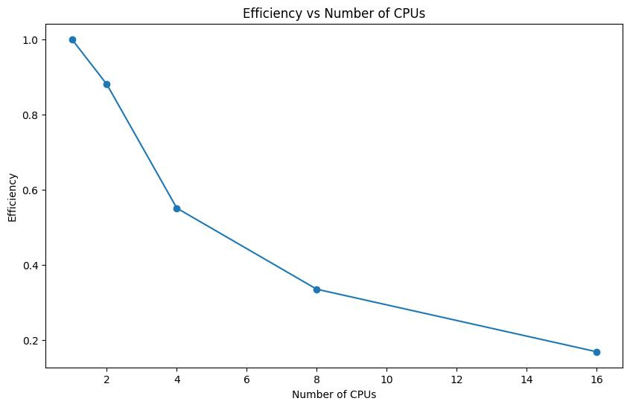
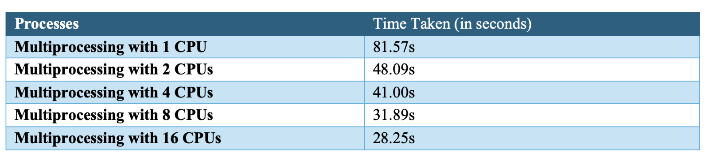
Results: EDA parallel

Slide 16
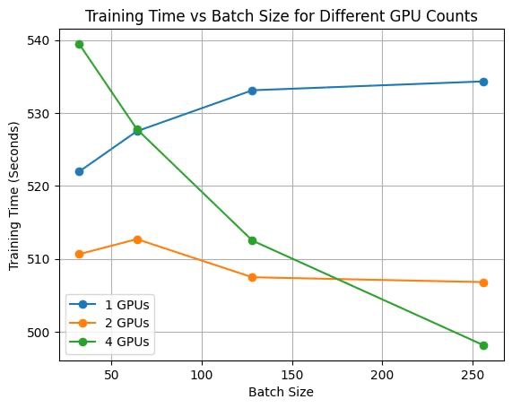
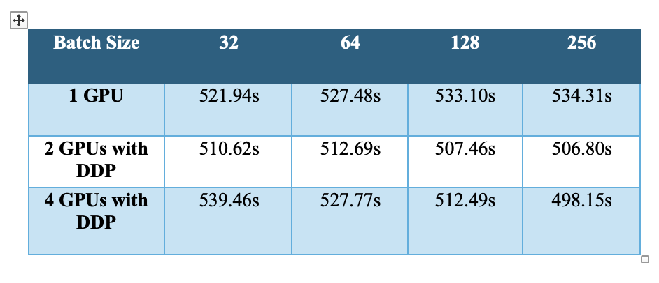
Results: DDP Training
Trained on NVIDIA Tesla V-100-SXM2 GPUs
Model trained on 1, 2, 4 GPUs for batch size 32, 64, 128,256
Notes:
Used cluster GPUs - > NVIDIA
Explain graph
This suggests that the single GPU's memory and compute capabilities are being exceeded by larger batch sizes. It implies that for a single GPU setup, smaller batch sizes are more optimal and that there's a limit to the computational load it can handle efficiently. Hence, we get a clear indication seeing the trend for single GPU that increasing the number of GPUs with increasing batch size may result in better training times.
This suggests that after increasing the batch size by a certain number the training times don’t get affected either ways. The initial decrease indicates that adding an extra GPU effectively doubles the computational resources, allowing for larger batch sizes to be processed more quickly. However, the plateau at larger batch sizes may indicate that the communication overhead between the two GPUs is counteracting the benefits of parallel processing. This infers that there's an optimal batch size before the efficiency gains from parallelism are negated by overhead.
This efficiency likely arises because with four GPUs, the workload is split into smaller, more manageable parts, allowing each GPU to process data simultaneously without waiting on the others. Additionally, this setup suggests that the communication overhead—often a concern when scaling up the number of GPUs—isn't significant enough to offset the time saved through parallel processing. The graph implies that the system is well-tuned and that the tasks and data size are large enough to truly benefit from the increased number of GPUs, illustrating that in some cases, scaling out (adding more GPUs) can indeed be more beneficial than scaling up (using larger, more powerful single GPUs).

Slide 17
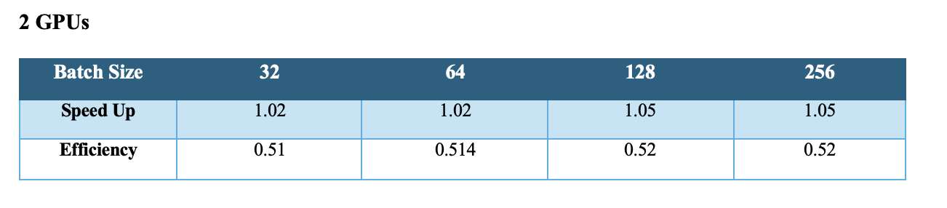
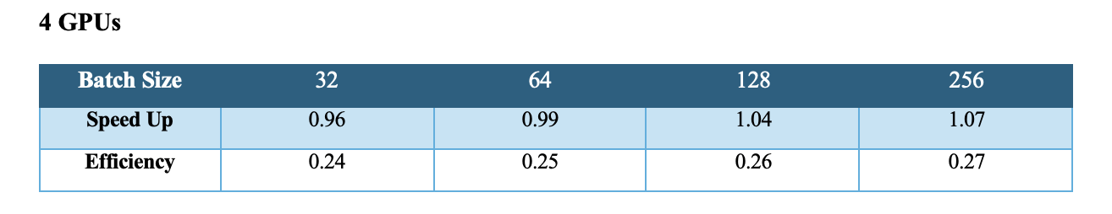
Speedup and Efficiency using DDP
Notes:
Speedup remains just above 1, suggesting that the training time with two GPUs is only slightly better than with one. The efficiency, which reflects the speedup per GPU, is consistently just over 0.5. This indicates that each GPU is not being fully utilized, as an efficiency of 1 would mean perfect scaling where doubling the number of GPUs halves the training time. The small increment in efficiency suggests some gains from parallelization, but also highlights a potential for improving the distribution of the workload or managing the computational overhead more effectively.

Slide 18
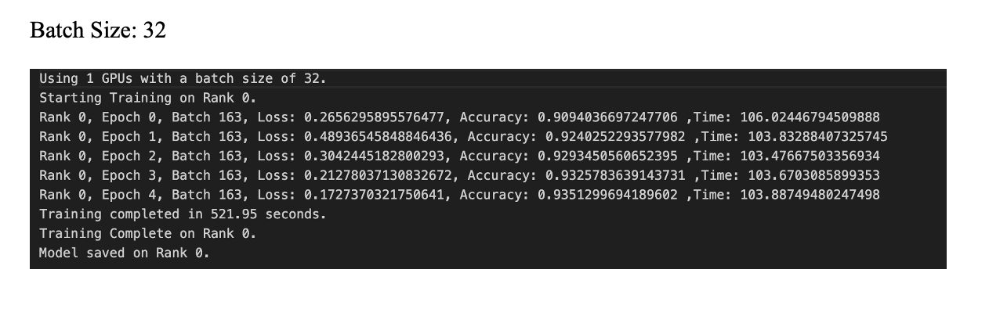
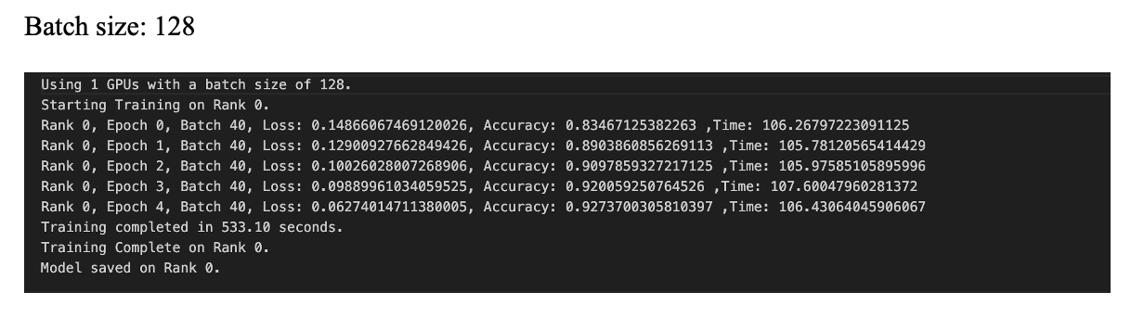
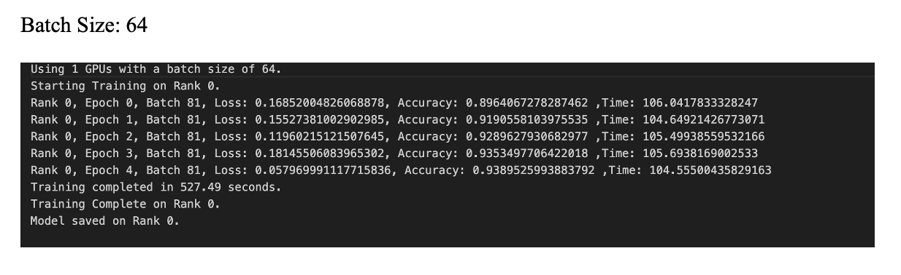
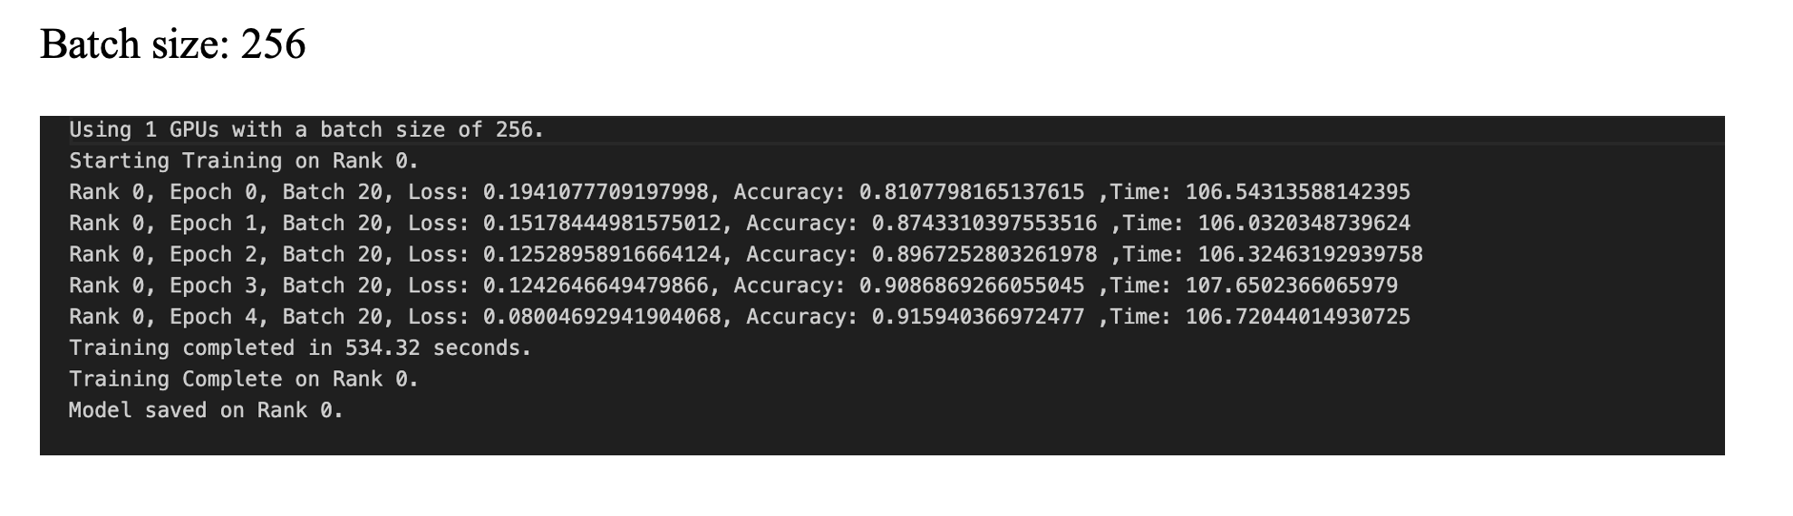
1 GPU

Slide 19
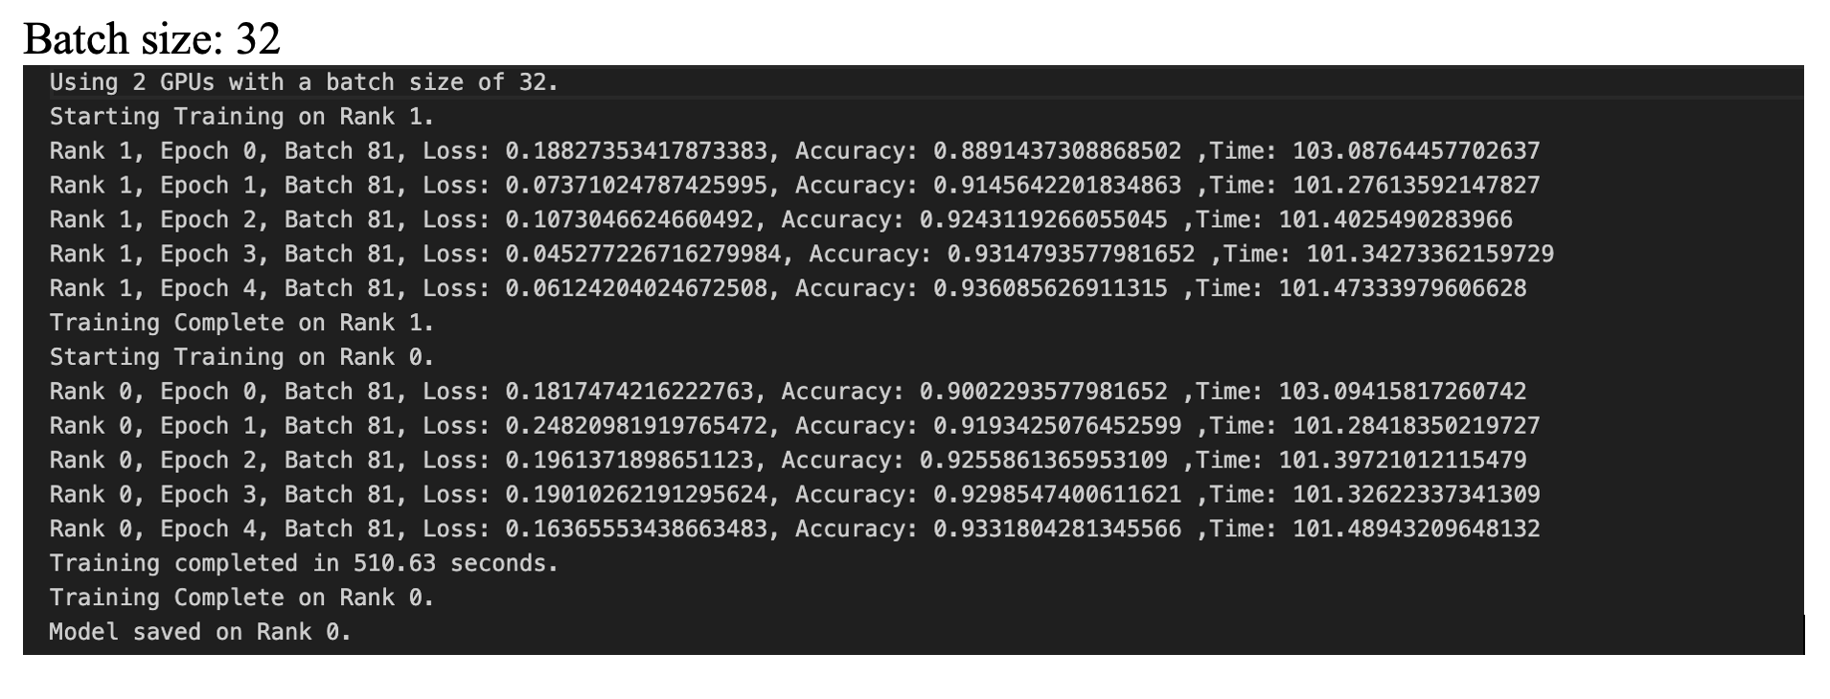
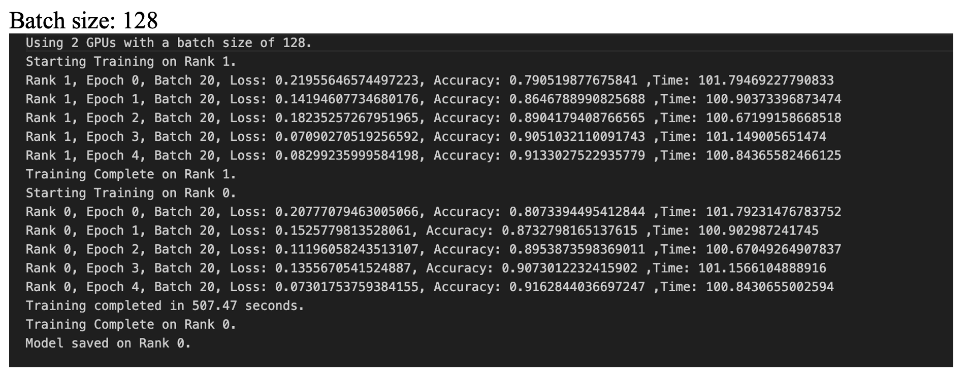
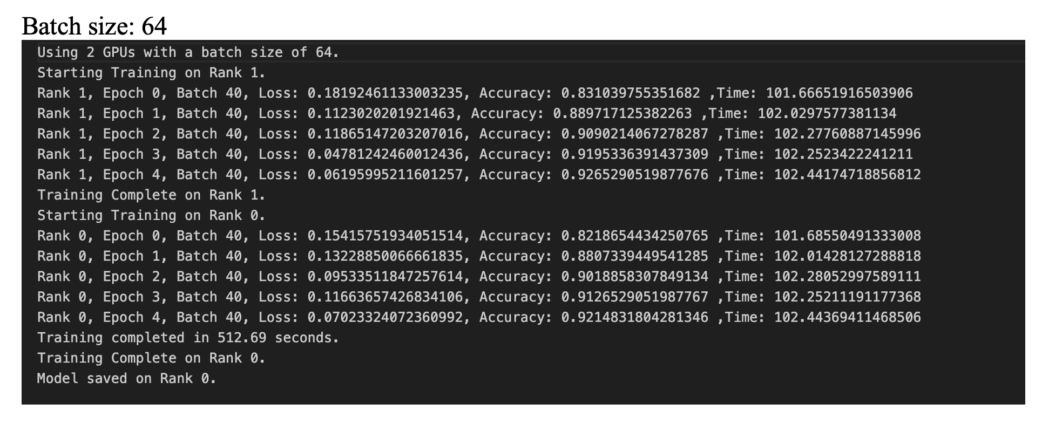
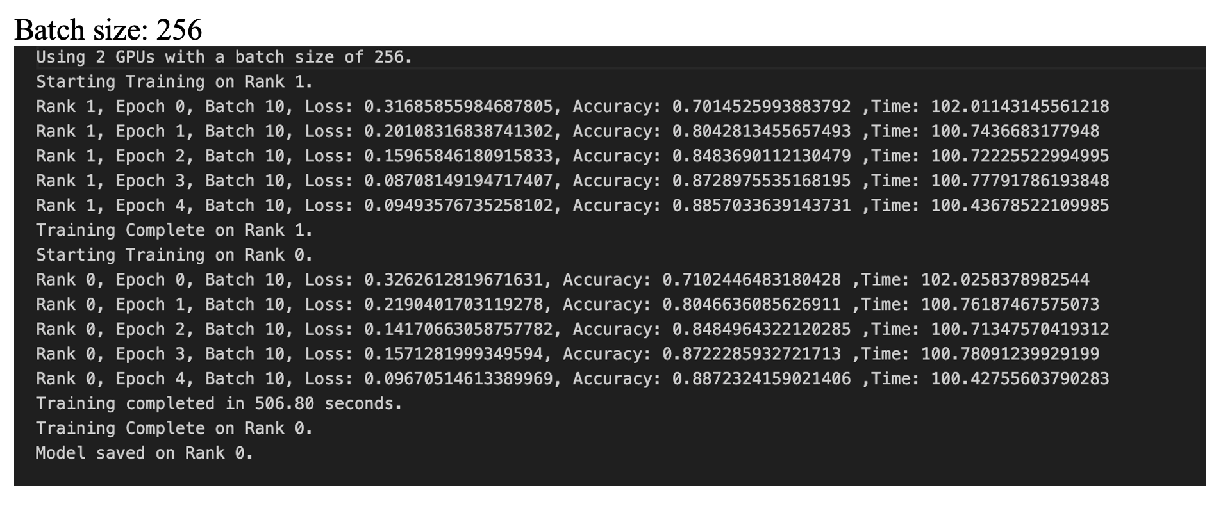
2 GPU​s

Slide 20
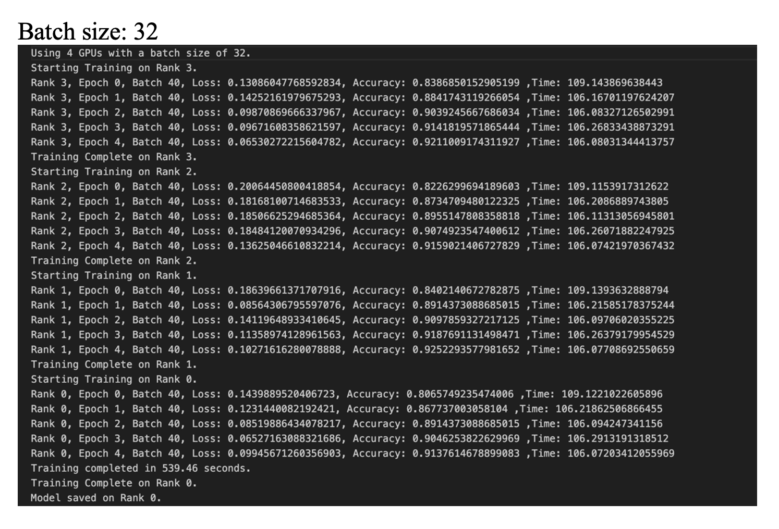
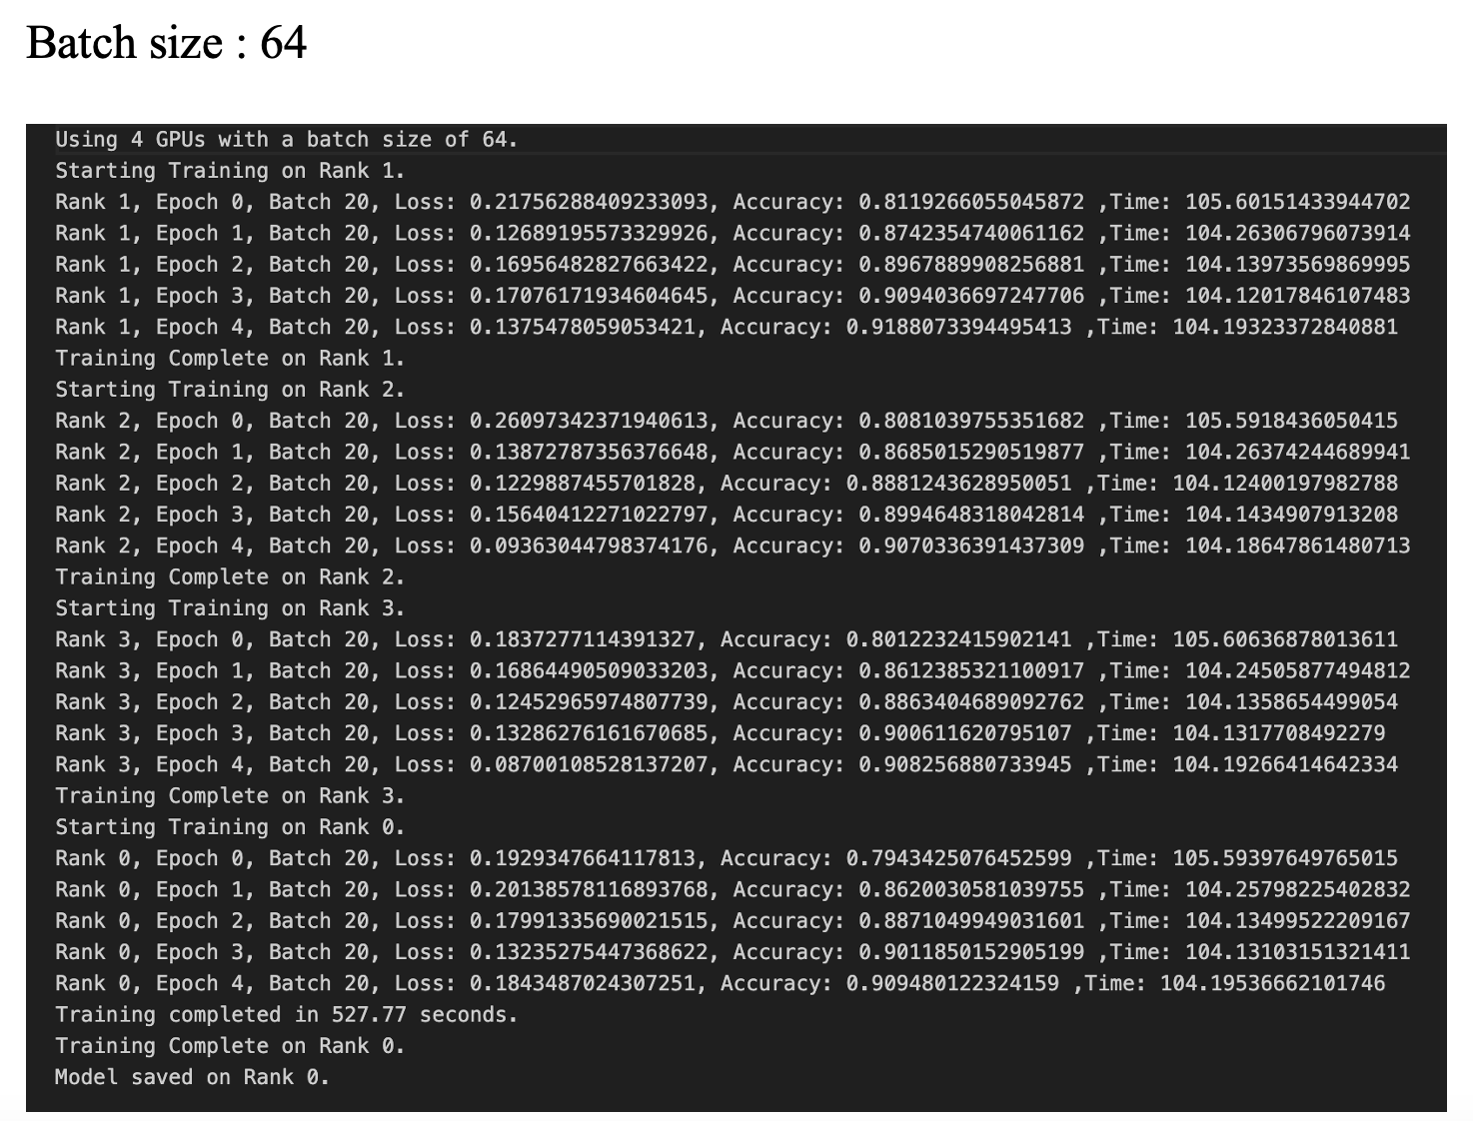
4 GPU​s

Slide 21
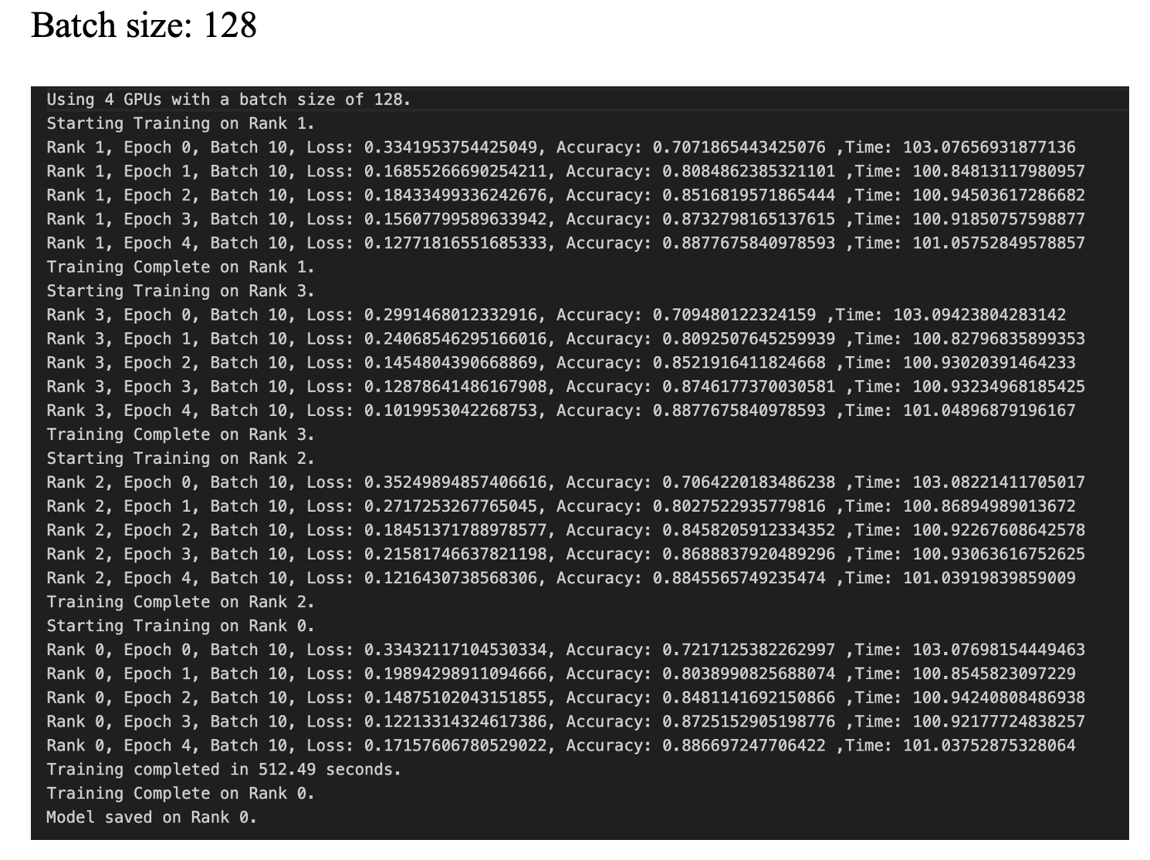
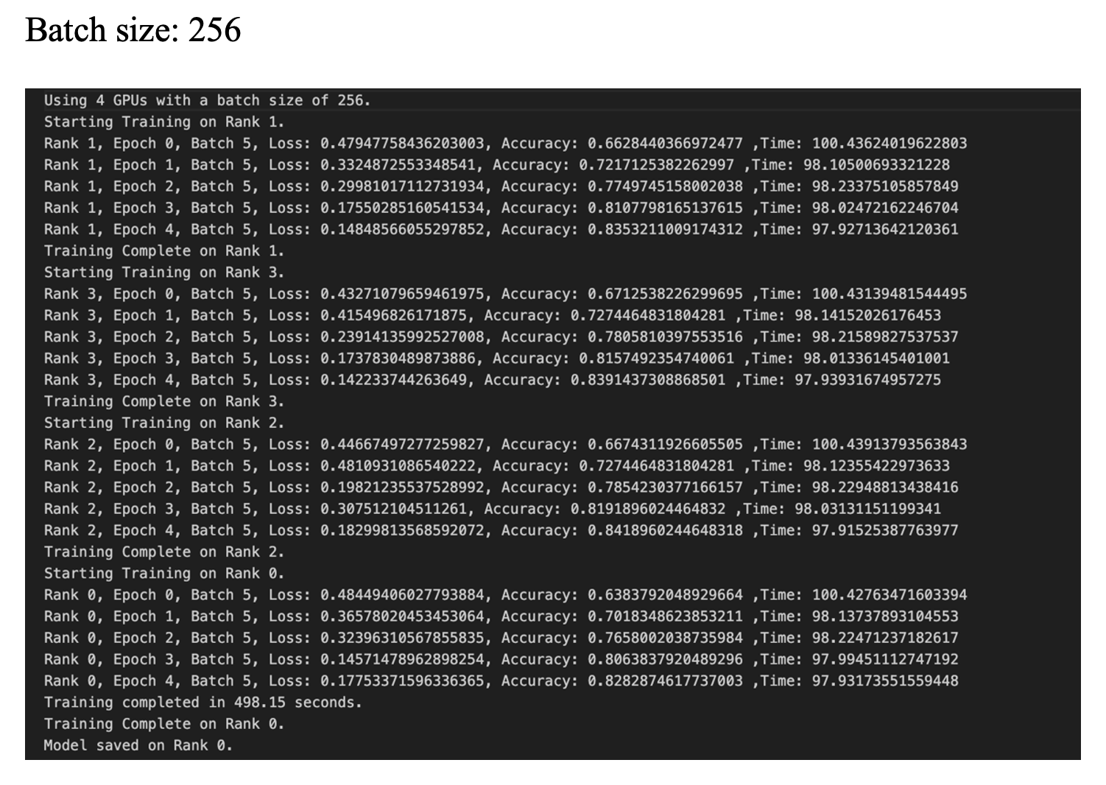
4 GPU​s​

Slide 22
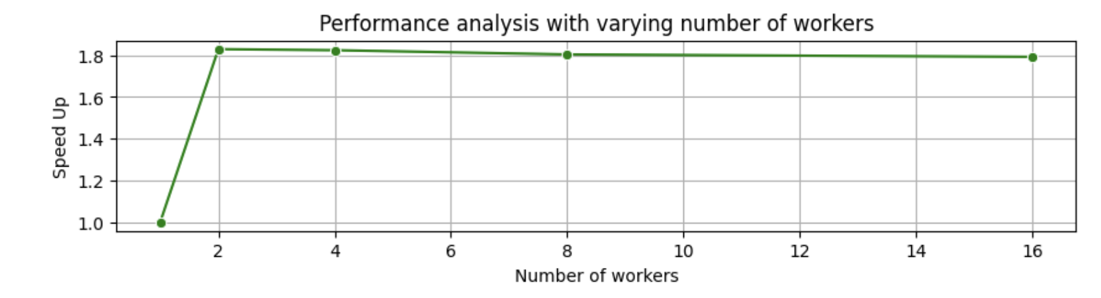
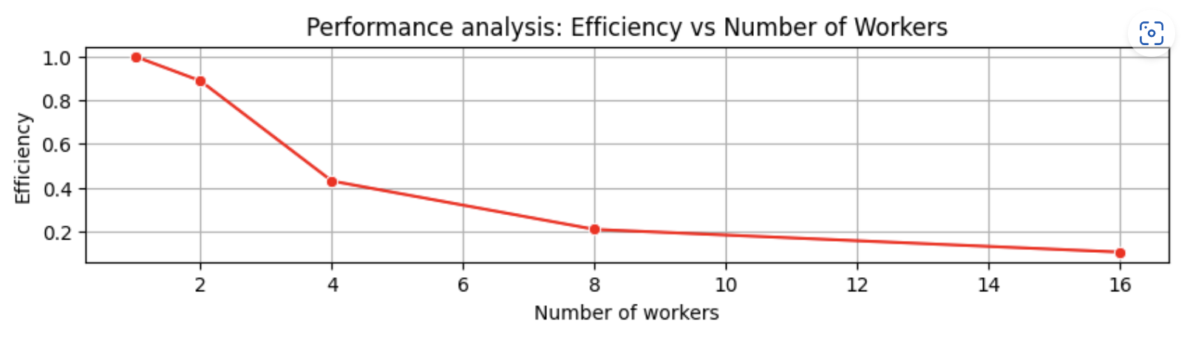
Results: Dask Performance Evaluation
Process | Time Taken (in Second)
Dask (with 1 worker) | 128
Dask (with 2 workers) | 78
Dask (with 4 workers) | 75
Dask (with 8 workers) | 74
Dask (with 16 workers) | 68

Slide 23
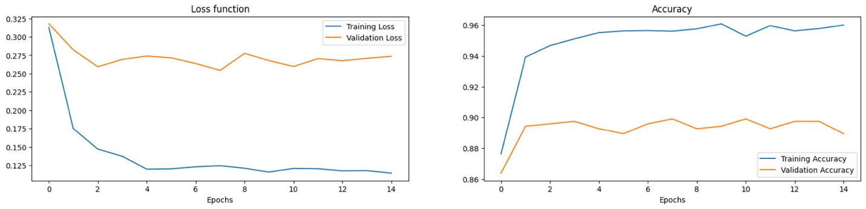
Model Evaluation
The model’s loss decreased and converged for both training and validation datasets, indicating effective learning without significant overfitting.
Accuracy for both training and validation increased and aligned closely by the end of training, suggesting excellent model generalization.
High final accuracy rates (~0.96) across both datasets demonstrate the model's strong performance in pattern recognition within the data.

Slide 24
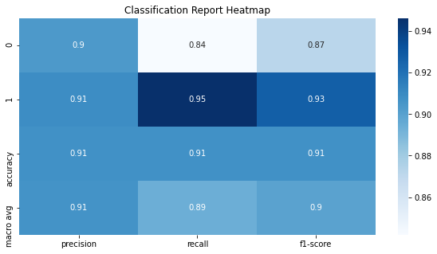
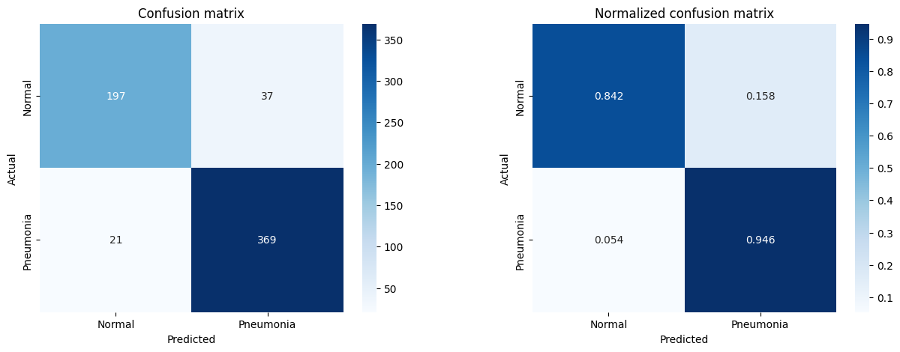
Confusion Matrix
Notes:
The above plots show that the model handles both the classes decently during the testing time. The confusion matrix suggests that the F1-score of both the classes is 0.87 and 0.93. It is acceptable in general terms. The precision and recall are also balanced. The testing accuracy is 0.91. From the normalized confusion matrix we can see that the True Positive Rate for both the classes is 0.842 and 0.946 respectively. So comparatively, the model can predict pneumonia images correctly than normal images relatively better.

Slide 25
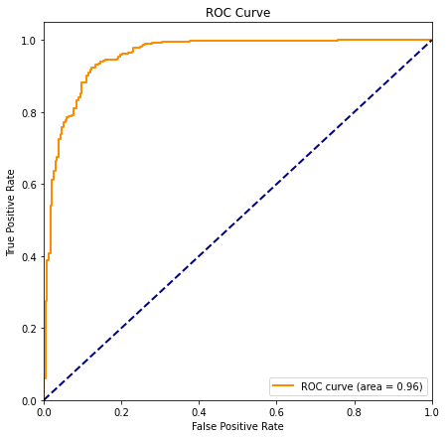
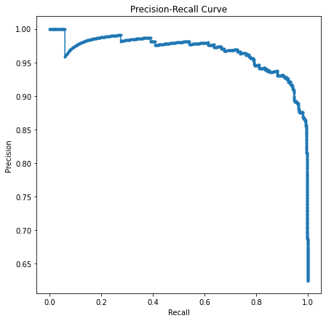
Notes:
High Precision: The high precision across most recall levels indicates that when the model predicts pneumonia, it is highly likely to be correct. This is particularly important in medical diagnostics to minimize the number of false alarms that can cause unnecessary anxiety and additional medical testing.
Precision Drop: The abrupt drop in precision at the high-recall end of the curve might represent the model beginning to misclassify some normal cases as pneumonia. It's critical to identify the threshold before this drop to maintain a balance between detecting as many true pneumonia cases as possible (high recall) and keeping the number of false positives (low precision) manageable.
An AUC of 0.96 suggests that the model has an excellent ability to discriminate between normal and pneumonia cases. For medical diagnostics, this indicates that the model has a strong capability to distinguish between the two classes with a low rate of false negatives and false positives.

Slide 26
Conclusion
Single-core synchronous execution is the baseline for performance, being the slowest method.
Multiprocessing reduces data loading time, optimizing resource use in data-heavy tasks.
DenseNet-161 with transfer learning accurately classifies chest X-rays.
DDP across multiple GPUs significantly shortens training time over single-GPU or CPU methods.
Larger batch sizes on 4-GPU setups with DDP improve efficiency and training speed.
Dask minimizes evaluation time while maintaining accuracy, enhancing workflow speed.
Optimal GPU count and batch size balance are key for best training efficiency and accuracy.

Slide 27
References
https://docs.python.org/3/library/multiprocessing.html
https://docs.dask.org/en/stable/
https://pytorch.org/tutorials/intermediate/ddp_tutorial.html
https://pytorch.org/docs/stable/index.html
https://data.mendeley.com/datasets/rscbjbr9sj/2
https://www.kaggle.com/code/writabrata/pneumonia-densenet121-82-accuracy
https://pytorch.org
https://medium.com/codex/a-comprehensive-tutorial-to-pytorch-distributeddataparallel-1f4b42bb1b51
https://pytorch.org/tutorials/intermediate/ddp_tutorial.html
https://www.kaggle.com/code/piehtvh/class-weight-for-imbalanced-pediatric-dataset
https://tutorial.dask.org/03_dask.delayed.html

Slide 28


